Slide 1
Two Techniques for Analyzing Malware
Somesh Jha
University of Wisconsin, Madison

Slide 2
Paper
Edward J. Schwartz, Thanassis Avgerinos, and David Brumley
  All You Ever Wanted to Know about Dynamic Taint Analysis and Forward Symbolic Execution (but Might Have Been Afraid to Ask).
  IEEE Symposium on Security and Privacy 2010

Slide 3
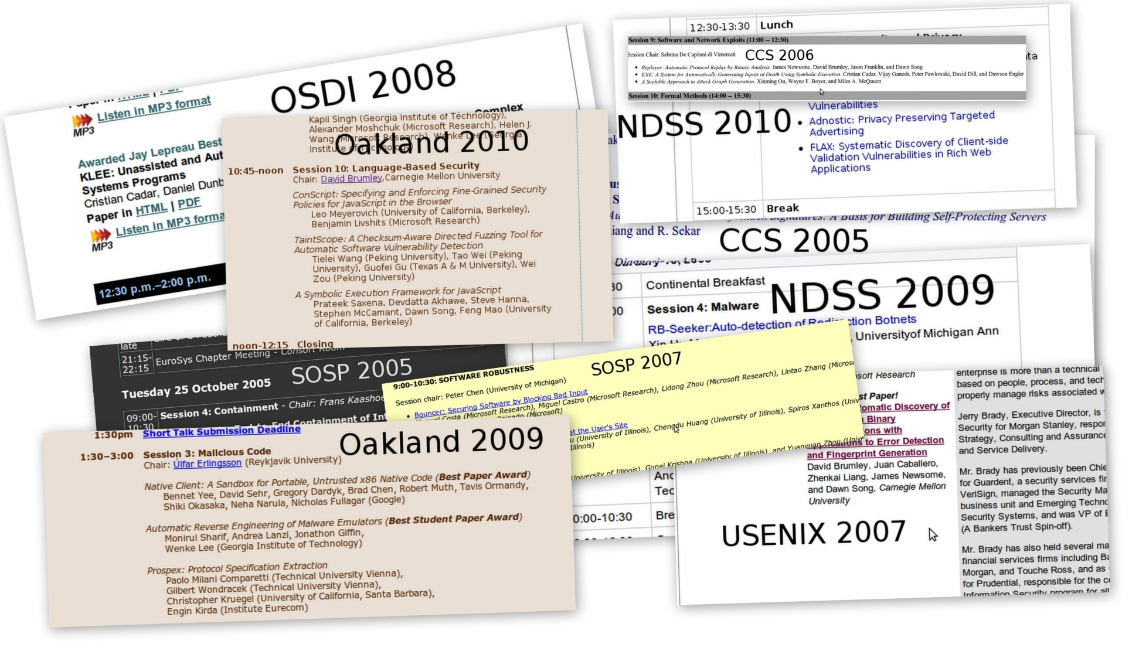
Two Essential Runtime Analyses
Detect Exploits [Costa2005,Crandall2005,
Newsome2005,Suh2004]
Detect
packing in malware [Bayer2009,Yin2007]
Dynamic Taint Analysis:
What values are derived from user input?
Automated Test Case Generation
[Cadar2008,Godefroid2005,Sen2005]
Input Filter Generation [Costa2007,Brumley2008]
Forward Symbolic Execution:
What input will make execution reach this line of code?

Slide 4
Our Contributions
Computers Analyzing Programs Dynamically at Runtime
1: Turn English descriptions into an algorithm
  Operational Semantics
2: Algorithm highlights caveats, issues, and unsolved problems that are deceptively hard
Dynamic Taint Analysis:
Is this value affected by user input?
Forward Symbolic Execution:
What input will make execution reach this line of code?

Slide 5
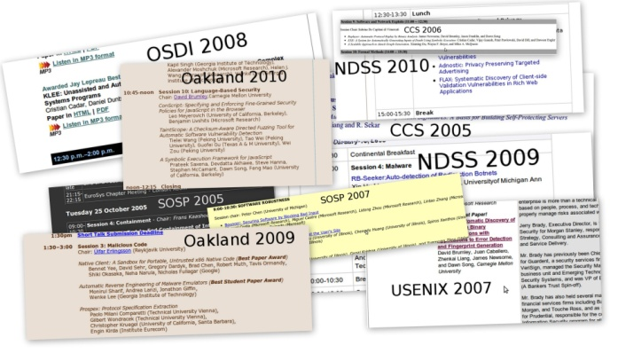
Our Contributions (cont’d)
3: Systematize recurring themes in a wealth of previous work

Slide 6
Dynamic Taint Analysis:
What values are derived from user input?
How it works – example
Desired properties
Example issue. Paper has many more.

Slide 7

Δ
tainted
untainted
Var
Val
x = get_input( )
y = x + 42
…
goto y
x
7
Input is tainted
τ
Taint Introduction
Var
Tainted?
t = IsUntrusted(src)
Input
x
T
get_input(src)↓ t

Slide 8
Δ
tainted
untainted
Var
Val
x = get_input( )
y = x + 42
…
goto y
x
7
y
49
Data derived from user input is tainted
τ
Taint Propagation
Var
Tainted?
t1 = τ[x1] , t2 = τ[x2]
BinOp
x
T
x1 + x2 ↓ t1 v t2
y
T

Slide 9
Δ
tainted
untainted
Var
Val
x = get_input( )
y = x + 42
…
goto y
x
7
y
49
Policy Violation
Detected
τ
Taint Checking
Var
Tainted?
Pgoto(ta) = ¬ ta
(Must be true to execute)
x
T
y
T

Slide 10
Real Use:
Exploit Detection
x = get_input( )
y = …
…
goto y
Jumping to overwritten return address
…
strcpy(buffer,argv[1]) ;
…
return ;

Slide 11
Memory Load
Variables
Memory
Δ
μ
Var
Val
Addr
Val
x
7
7
42
τ
τμ
Var
Tainted?
Addr
Tainted?
x
T
7
F

Slide 12
Problem: Memory Addresses
Var
Val
Δ
x = get_input( )
y = load( x )
…
goto y
x
7
Addr
Val
μ
7
42
All values derived from user input are tainted??
Addr
Tainted?
τμ
7
F

Slide 13
Policy 1:
Taint depends only on the memory cell
Var
Val
Δ
x = get_input( )
y = load( x )
…
goto y
Undertainting
Failing to identify tainted values
- e.g., missing exploits
x
7
Jump target could be any untainted memory cell value
Addr
Val
μ
7
42
Taint Propagation
Addr
Tainted?
v = Δ[x] , t = τμ[v]
τμ
Load
load(x) ↓ t
7
F

Slide 14
Policy 2:
If either the address or the memory cell is tainted, then the value is tainted
Memory
printa
printb
x = get_input( )
y = load(jmp_table + x % 2 )
…
goto y
Overtainting
Unaffected values are tainted
- e.g., exploits on safe inputs
Address expression is tainted
jmp_table
Policy Violation?
Taint Propagation
v = Δ[x] , t = τμ[v], ta = τ[x]
Load
load(x) ↓ t v ta

Slide 15
Research Challenge
State-of-the-Art is not perfect for all programs
Undertainting:
Policy may miss taint
Overtainting:
Policy may wrongly detect taint

Slide 16
Forward Symbolic Execution:
What input will make execution reach this line of code?
How it works – example
Inherent problems of symbolic execution
Proposed solutions

Slide 17
The Challenge
bad_abs(x is input)
if (x < 0) then
return -x
if (x = 0x12345678) then
return -x
return x
2³² possible inputs
0x12345678
Forward Symbolic Execution:
What input will make execution reach this line of code?

Slide 18
A Simple Example
x symbolic
can have any value
Interpreter
bad_abs(x is input)
What input will make execution reach this line of code?
Interpreter
Interpreter
If (x < 0)
x ≥ 0
t
f
Interpreter
return -x
Interpreter
If x == 0x12345678
f
t
x < 0
return x
return -x
x ≥ 0 Λ
x != 0x12345678
x ≥ 0 Λ
x == 0x12345678

Slide 19
One Problem:
Exponential Blowup Due to Branches
Interpreter
Branch 1
Branch 2
Branch 3
Exponential Number of Interpreters/formulas in # of branches

Slide 20
Path Selection Heuristics
Symbolic Execution Tree
However, these are heuristics. In the worst case all create an exponential number of formulas in the tree height.
…
Depth-First Search (bounded) ,Random Search [Cadar2008]
Concolic Testing [Sen2005,Godefroid2008]

Slide 21
Symbolic Execution is not Easy
Exponential number of interpreters/formulas
Exponentially-sized formulas
Solving a formula is NP-Complete!
branching
s + s + s + s +
s + s + s + s == 42
substitution

Slide 22
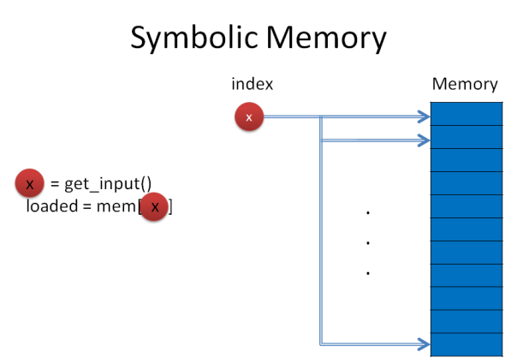
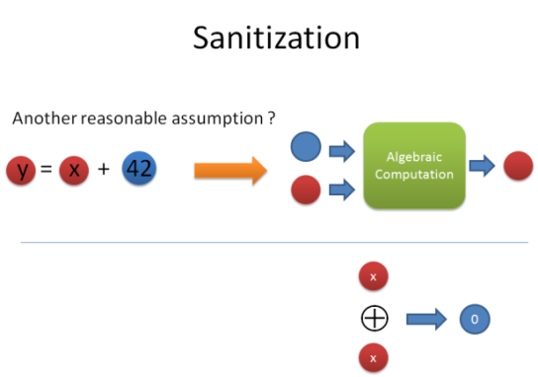
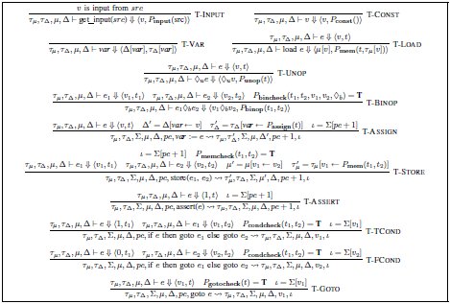
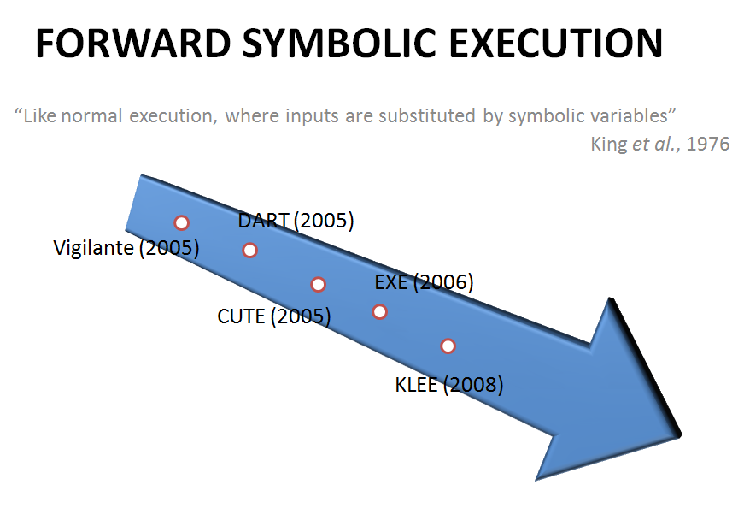
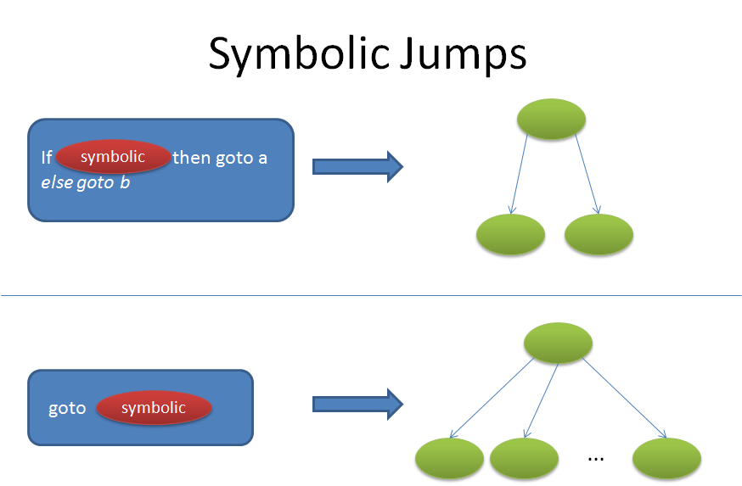
Other Important Issues
Formalization
More complex policies
Π = (s + s + s + s +
s + s + s + s) == 42

Slide 23
Conclusion
Dynamic taint analysis and forward symbolic execution used extensively in literature
  Formal algorithm and what is done for each possible step of execution often not emphasized
We provided a formal definition and summarized
  Critical issues
  State-of-the-art solutions
  Common tradeoffs

Slide 24
Malware Clustering
Ulrich Bayer, Paolo Milani Comparetti, Clemens Hlauschek, Christopher Krügel, Engin Kirda
  Scalable, Behavior-Based Malware Clustering.
  NDSS 2009

Slide 25
Motivation
Thousands of new malware samples appear each day
Automatic analysis systems allow us to create thousands of analysis reports
Now a way to group the reports is needed. We would like to cluster them into sets of malware reports that exhibit similar behavior.
  we require automated clustering techniques
Clustering allows us to:
  discard reports of samples that have been seen before
  guide an analyst in the selection of those samples that require most attention
  derive generalized signatures, implement removal procedures that work for a whole class of samples
Notes:
As most of you are probably aware we are seeing thousands of new malware samples appearing each day.
To cope with this flood of malware samples, automatic analysis systems were created. These systems analyze the sample without any user intervention and produce some form of analysis report that describes the behavior of the analyzed sample. Now the problem is that the analyst of an A/V company is facing thousands of new analysis reports per day instead of thousands of new samples.
What is needed is a mechanism to structure these reports. If we can determine, for example, that 2000 reports are similar then the analyst can simply look at one representative report for the whole group of 2000 samples.
He can then decide to ignore a new sample because it belongs to a malware family he has already seen before. Or he decides to manually inspect a binary from this group because the automated analysis result might be not sufficiently complete.
Finally, it is possible to derive generalized signatures and implement removal procedures that work for a whole class of samples.

Slide 26
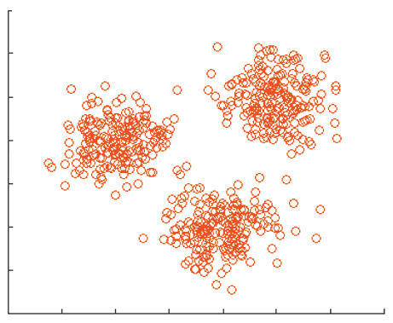
Scalable, Behavior-Based Malware Clustering
Malware Clustering: Find a partitioning of a given set of malware samples into subsets so that subsets share some common traits (i.e., find “virus families”)
Behavior-Based: A malware sample is represented by its actions performed at run-time
Scalable: It has to work for large sets of malware samples
Notes:
Now, I want to describe the term ‘clustering’ more formally. The idea of clustering malware is to find a partitioning of a given malware set into subsets so that subsets share some common traits.
I have tried to visualize this process in the graph that you can see on the slide: All the red circles represent malware samples. The goal of clustering is to find the malware samples that are near. Thus, in our example, we would like to have the clustering algorithm find three clusters. Of course, this is a very simplistic view. In reality, we cannot describe a malware sample with only two dimensions.
The question is of course, when are two malware samples similar? When shall we put them into the same cluster? We are following a behavior-based approach. We think that malware is best represented by its behavior. That means two malware samples are similar when their behavior is similar. If we have two malware samples that both create the same files, download the same files…. Then they are quite similar.
Having a clustering algorithm that is scalable is one of its decisive properties. We are not the first ones proposing to cluster or somehow classify malware. However besides other shortcomings, previous approaches do not scale well and are too slow for the size of malware sets that anti-malware companies are confronted with. Of course, it’s nice if you can cluster 500 malware samples but the actual point of trying to find a structure in malware samples is because of the overwhelming number of existing malware samples. Clustering 500 samples that I can also do manually.

Slide 27
System Overview
Dynamic Analysis of the Sample
Result
Execution Trace augmented
with taint-information and
network analysis results
Input
Extraction
of the
Behavioral Profile
Result
Behavioral Profile
Input
Clustering
Notes:
Now, I’d like to give you an overview of how our clustering system works.
Clustering malware samples is a three-step process in our system. I have illustrated these three steps as ellipses on the slide.
The first step in the clustering process is the automatic dynamic analysis of a sample. This means that we execute the program in a safe environment and monitor its actions. The result of this process is an execution trace that lists all the system calls that were performed by the program. In addition to the system call trace, we collect taint information and analyze the network traffic.
In the next step, the extraction of the behavioral profile, we process the results provided by the dynamic analysis step. Since the system call trace is a very raw, a very basic representation, we would like to generalize it. So in the step called ‘Extraction of the Behavioral Profile’ we abstract the existing execution trace into a representation consisting of OS objects, OS operations that are performed on these objects and dependences between the OS Objects. This representation is what we call a “Behavioral Profile”.
The behavioral profile is finally the representation that serves as input to our clustering algorithm. Of course, a single behavioral profile would not be enough. Instead, we normally have thousands of behavioral profiles that we want to be clustered by our clustering algorithm.
I’m going to describe each of these steps in more detail, now.

Slide 28
Dynamic Analysis
Based on our existing automatic, dynamic analysis system called Anubis
  Anubis is a full-system emulator
  Anubis generates an execution trace listing all invoked system calls
In this work, we extended Anubis with:
  system call dependencies (Tainting)
  control flow dependencies
  network analysis (for accurately describing a sample’s network behavior)
Output of this step: Execution trace augmented with taint information and network analysis results
Notes:
At the beginning of the clustering process, there is the dynamic analysis. For this purpose , we are using our existing automatic, dynamic analysis system, called Anubis. Anubis was already able to provide us with a system call trace.
However, we have also extended the analysis capabilities of Anubis with several features, most notably system call dependences, control flow dependences and a networking analysis component. It is clear that a good and correct analysis is a prerequisite for a good clustering. If the analysis of a malware sample is already wrong, then the clustering of this sample will also be wrong.
We capture system call dependences based on a tainting system.
In addition to tracking the taint relationships between system calls it is also interesting to analyze how tainted data is used inside the program. To this end, we keep track of compare operations involving tainted data.
We require a network analysis component for accurately describing a sample’s network behavior. In short, we want to know whether any emails are sent, we want to see the IRC traffic, which usernames and channel names were used etc.
The output of the dynamic analysis step is an execution trace augmented with taint information and network analysis results. Before describing how this output is processed in the ‘extraction of behavioral profile’ phase I will say a few words about the two features that we’ve implemented.

Slide 29
Extraction Of The Behavioral Profile
In this step, we process the execution trace provided by the ‘dynamic analysis’ step
Goal: abstract from the system call trace
  system calls can vary significantly, even between programs that exhibit the same behavior
  remove execution-specific artifacts from the trace
A behavioral profile is an abstraction of the program's execution trace that accurately captures the behavior of the binary

Slide 30
Reasons For An Abstract Behavioral Description
Different ways to read from a file:
Different system calls with similar semantics
  e.g., NtCreateProcess, NtCreateProcessEx
You can easily interleave the trace with unrelated calls:
f = fopen(“C:\\test”);
read(f, 1);
read(f, 1);
read(f, 1);
B:
f = fopen(“C:\\test”);
read(f, 3);
A:
f = fopen(“C:\\test”);
read(f, 1);
readRegValue(..);
read(f, 1);
C:

Slide 31
Reasons For An Abstract Behavioral Description
Different ways to read from a file:
Different system calls with similar semantics
  e.g., NtCreateProcess, NtCreateProcessEx
You can easily interleave the trace with unrelated calls:
f = fopen(“C:\\test”);
read(f, 1);
read(f, 1);
read(f, 1);
B:
f = fopen(“C:\\test”);
read(f, 3);
A:
f = fopen(“C:\\test”);
read(f, 1);
readRegValue(..);
read(f, 1);
C:

Slide 32
Reasons For An Abstract Behavioral Description
Different ways to read from a file:
Different system calls with similar semantics
  e.g., NtCreateProcess, NtCreateProcessEx
You can easily interleave the trace with unrelated calls:
f = fopen(“C:\\test”);
read(f, 1);
read(f, 1);
read(f, 1);
B:
f = fopen(“C:\\test”);
read(f, 3);
A:
f = fopen(“C:\\test”);
read(f, 1);
readRegValue(..);
read(f, 1);
C:

Slide 33
Reasons For An Abstract Behavioral Description
Different ways to read from a file:
Different system calls with similar semantics
  e.g., NtCreateProcess, NtCreateProcessEx
You can easily interleave the trace with unrelated calls:
f = fopen(“C:\\test”);
read(f, 1);
read(f, 1);
read(f, 1);
B:
f = fopen(“C:\\test”);
read(f, 3);
A:
f = fopen(“C:\\test”);
read(f, 1);
readRegValue(..);
read(f, 1);
C:

Slide 34
Reasons For An Abstract Behavioral Description
Different ways to read from a file:
Different system calls with similar semantics
  e.g., NtCreateProcess, NtCreateProcessEx
You can easily interleave the trace with unrelated calls:
f = fopen(“C:\\test”);
read(f, 1);
read(f, 1);
read(f, 1);
B:
f = fopen(“C:\\test”);
read(f, 3);
A:
f = fopen(“C:\\test”);
read(f, 1);
readRegValue(..);
read(f, 1);
C:

Slide 35
Elements Of A Behavioral Profile
OS Objects: represent a resource such as a file that can be manipulated via system calls
  has a name and a type
OS Operations: generalization of a system call
  carried out on an OS object
  the order of operations is irrelevant
  the number of operations on a certain resource does not matter
Object Dependencies: model dependencies between OS objects (e.g., a copy operation from a source file to a target file)
  also reflect the true order of operations
Control Flow Dependencies: reflect how tainted data is used by the program (comparisons with tainted data)
Notes:
In order to avoid the mentioned shortcomings of system call traces we decided to introduce behavioral profiles.
A behavioral profile conceptually consists of four different components.
We map system calls to OS operations with the intent of abstracting from API specific details. For example, we ignore whether a process is created by means of NtCreateProcess or NtCreateProcessEx and unify these two system calls into the single OS operation create.
The order of operations does not matter, instead we have dependencies for the real dependenceis

Slide 36
Example: Behavioral Profile
src = NtOpenFile(“C:\\sample.exe”);
// memory map the target file
dst = NtCreateFile(“C:\\Windows\\” + GetTempFilename());
dst_section = NtCreateSection(dst);
char *base = NtMapViewOfSection(dst_section);
while(len < length(src)) {
*(base+len)=NtReadFile(src, 1); len++; }
Op|File|C:\sample.exe
open:1, read:1
Op|File|RANDOM_1
create:1
Op|Section|RANDOM_1
open:1, map:1, mem_write: 1
Dep|File|C:\sample.exe -> Section|RANDOM_1
read – mem_write
Notes:
The best way to explain a behavioral profile is to show an example and to show how the mapping from an execution trace to a behavioral profile works.
Please note that although the example is shown in C code our algorithm works on execution traces.
Things to note:
the order of OS operations is irrelevant. This is important, because it is very easy to reorder system calls on a resource without changing the semantics of a program.
Moreover the number of operations on a certain resource does not matter in our system.

Slide 37
Example: Behavioral Profile
src = NtOpenFile(“C:\\sample.exe”);
// memory map the target file
dst = NtCreateFile(“C:\\Windows\\” + GetTempFilename());
dst_section = NtCreateSection(dst);
char *base = NtMapViewOfSection(dst_section);
while(len < length(src)) {
*(base+len)=NtReadFile(src, 1); len++; }
Op|File|C:\sample.exe
open:1, read:1
Op|File|RANDOM_1
create:1
Op|Section|RANDOM_1
open:1, map:1, mem_write: 1
Dep|File|C:\sample.exe -> Section|RANDOM_1
read – mem_write
Notes:
Things to note:
the order of OS operations is irrelevant. This is important, because it is very easy to reorder system calls on a resource without changing the semantics of a program.
Moreover the number of operations on a certain resource does not matter in our system.

Slide 38
Example: Behavioral Profile
src = NtOpenFile(“C:\\sample.exe”);
// memory map the target file
dst = NtCreateFile(“C:\\Windows\\” + GetTempFilename());
dst_section = NtCreateSection(dst);
char *base = NtMapViewOfSection(dst_section);
while(len < length(src)) {
*(base+len)=NtReadFile(src, 1); len++; }
Op|File|C:\sample.exe
open:1, read:1
Op|File|RANDOM_1
create:1
Op|Section|RANDOM_1
open:1, map:1, mem_write: 1
Dep|File|C:\sample.exe -> Section|RANDOM_1
read – mem_write
Notes:
Things to note:
the order of OS operations is irrelevant. This is important, because it is very easy to reorder system calls on a resource without changing the semantics of a program.
Moreover the number of operations on a certain resource does not matter in our system.

Slide 39
Example: Behavioral Profile
src = NtOpenFile(“C:\\sample.exe”);
// memory map the target file
dst = NtCreateFile(“C:\\Windows\\” + GetTempFilename());
dst_section = NtCreateSection(dst);
char *base = NtMapViewOfSection(dst_section);
while(len < length(src)) {
*(base+len)=NtReadFile(src, 1); len++; }
Op|File|C:\sample.exe
open:1, read:1
Op|File|RANDOM_1
create:1
Op|Section|RANDOM_1
open:1, map:1, mem_write: 1
Dep|File|C:\sample.exe -> Section|RANDOM_1
read – mem_write
Notes:
Things to note:
the order of OS operations is irrelevant. This is important, because it is very easy to reorder system calls on a resource without changing the semantics of a program.
Moreover the number of operations on a certain resource does not matter in our system.

Slide 40
Example: Behavioral Profile
src = NtOpenFile(“C:\\sample.exe”);
// memory map the target file
dst = NtCreateFile(“C:\\Windows\\” + GetTempFilename());
dst_section = NtCreateSection(dst);
char *base = NtMapViewOfSection(dst_section);
while(len < length(src)) {
*(base+len)=NtReadFile(src, 1); len++; }
Op|File|C:\sample.exe
open:1, read:1
Op|File|RANDOM_1
create:1
Op|Section|RANDOM_1
open:1, map:1, mem_write: 1
Dep|File|C:\sample.exe -> Section|RANDOM_1
read – mem_write
Notes:
Things to note:
the order of OS operations is irrelevant. This is important, because it is very easy to reorder system calls on a resource without changing the semantics of a program.
Moreover the number of operations on a certain resource does not matter in our system.

Slide 41
Example: Behavioral Profile
src = NtOpenFile(“C:\\sample.exe”);
// memory map the target file
dst = NtCreateFile(“C:\\Windows\\” + GetTempFilename());
dst_section = NtCreateSection(dst);
char *base = NtMapViewOfSection(dst_section);
while(len < length(src)) {
*(base+len)=NtReadFile(src, 1); len++; }
Op|File|C:\sample.exe
open:1, read:1
Op|File|RANDOM_1
create:1
Op|Section|RANDOM_1
open:1, map:1, mem_write: 1
Dep|File|C:\sample.exe -> Section|RANDOM_1
read – mem_write
Notes:
Things to note:
the order of OS operations is irrelevant. This is important, because it is very easy to reorder system calls on a resource without changing the semantics of a program.
Moreover the number of operations on a certain resource does not matter in our system.

Slide 42
Example: Behavioral Profile
src = NtOpenFile(“C:\\sample.exe”);
// memory map the target file
dst = NtCreateFile(“C:\\Windows\\” + GetTempFilename());
dst_section = NtCreateSection(dst);
char *base = NtMapViewOfSection(dst_section);
while(len < length(src)) {
*(base+len)=NtReadFile(src, 1); len++; }
Op|File|C:\sample.exe
open:1, read:1
Op|File|RANDOM_1
create:1
Op|Section|RANDOM_1
open:1, map:1, mem_write: 1
Dep|File|C:\sample.exe -> Section|RANDOM_1
read – mem_write
Notes:
Things to note:
the order of OS operations is irrelevant. This is important, because it is very easy to reorder system calls on a resource without changing the semantics of a program.
Moreover the number of operations on a certain resource does not matter in our system.

Slide 43
Example: Behavioral Profile
src = NtOpenFile(“C:\\sample.exe”);
// memory map the target file
dst = NtCreateFile(“C:\\Windows\\” + GetTempFilename());
dst_section = NtCreateSection(dst);
char *base = NtMapViewOfSection(dst_section);
while(len < length(src)) {
*(base+len)=NtReadFile(src, 1); len++; }
Op|File|C:\sample.exe
open:1, read:1
Op|File|RANDOM_1
create:1
Op|Section|RANDOM_1
open:1, map:1, mem_write: 1
Dep|File|C:\sample.exe -> Section|RANDOM_1
read – mem_write
Notes:
Things to note:
the order of OS operations is irrelevant. This is important, because it is very easy to reorder system calls on a resource without changing the semantics of a program.
Moreover the number of operations on a certain resource does not matter in our system.

Slide 44
Example: Behavioral Profile
src = NtOpenFile(“C:\\sample.exe”);
// memory map the target file
dst = NtCreateFile(“C:\\Windows\\” + GetTempFilename());
dst_section = NtCreateSection(dst);
char *base = NtMapViewOfSection(dst_section);
while(len < length(src)) {
*(base+len)=NtReadFile(src, 1); len++; }
Op|File|C:\sample.exe
open:1, read:1
Op|File|RANDOM_1
create:1
Op|Section|RANDOM_1
open:1, map:1, mem_write: 1
Dep|File|C:\sample.exe -> Section|RANDOM_1
read – mem_write
Notes:
Things to note:
the order of OS operations is irrelevant. This is important, because it is very easy to reorder system calls on a resource without changing the semantics of a program.
Moreover the number of operations on a certain resource does not matter in our system.

Slide 45
Scalable Clustering
Most clustering algorithms require to compute the distances between all pairs of points => O(n²)
We use LSH (locality sensitive hashing), a technique introduced by Indyk and Motwani, to compute an approximate clustering that requires less than n² distance computations
Our clustering algorithm takes as input a set of malware samples where each malware sample is represented as a set of features
  we have to transform each behavioral profile into a feature set first
Our similarity measure: Jaccard Index defined as
Notes:
So now that we’ve seen how the behavioral profile looks like let me now talk about the clustering and why we think our clustering is more scalable then previous approaches.
The point is that most clustering algorithms require to compute n square distances when you want to cluster n samples. We avoid doing that by using a technique called Locality Sensitive Hashing. Locality sensitive hashing or LSH for short is a technique introduced by indyk and motwanti that allows us to compute an approximate clustering that requires less then n square distance calculations.
So with LSH we have a scalable clustering algorithm. However, it also limits our choices for a similarity function. For being able to make use of LSH we need to use the Jaccard index that operates on feature sets. So we have a very simply transformation going on that translates behavioral profiles to feature sets.
The Jaccard index is sometimes known as the set similarity and is formally defined by the intersection devided by the union of two features.
A similarity value of 1 indicates that two samples behave identical.

Slide 46
LSH Clustering
We are performing an approximate, single-linkage hierarchical clustering:
Step 1: Locality Sensitive Hashing
  to cluster a set of samples we have to choose a similarity threshold t
  the result is an approximation of the true set of all near (as defined by the parameter t) pairs
Step 2: Single-Linkage hierarchical clustering
Notes:
Our LSH-based clustering algorithm consists actually of two steps.
First, we are doing the locality sensitive hashing. This step requires us to specify a similarity threshold argument t. This argument determines whether two samples are put into the same cluster or not. For instance, a value of 0.7 means that samples need to similarity score of 0.7 to end up in the same cluster. We have analyzed the selection of t and found out that the selection of the correct value of t is quite robust. Indeed, for a broad range of values for t we get good clustering results. What LSH allows us to do then is to calculate a good approximation of the set of all near sample pairs. With near sample pairs I mean all the pairs that have a similarity value greater than t.
In Step 2 we calculate the actual distances for our set of near pairs (but not for the others pairs ) and then do a hierarchical, single-linkage clustering.

Slide 47
Evaluating Clustering Quality
For assessing the quality of the clustering algorithm, we compare our clustering results with a reference clustering of the same sample set
  since no reference clustering for malware exists, we had to create it first
Reference Clustering:
  we obtained a random sampling of 14,212 malware samples that were submitted to Anubis from Oct. 27th 2007 to Jan. 31st 2008
  we scanned each sample with 6 different virus scanners
  we selected only those samples for which the majority of the anti-virus programs reported the same malware family. This resulted in a total of 2,658 samples.
  we manually corrected classification problems
Notes:
Let me now come to the evaluation and to the experiments that we conducted.
Our first goal was to evaluate the quality of the clustering produced by our algorithm. Does it makes any sense or does it randomly group samples together?
We decided the best way to do this would be to compare our clustering to a reference clustering, to a ground truth set.
Unfortunately, such a reference clustering did not exist for malware. That’s why we had to create it ourselves.
So for creating the reference clustering we randomly selected around 14 000 files out from all the Anubis submissions during a period of roughly three months.
Our idea was to get a first, coarse clustering by using virus scanners. We scanned the files and extracted the family name from the label. We discarded the variant part.
A problem is of course that virus scanners are not particularly good at labeling malware. It’s also not their job, their job is to detect malicious samples at the end of the day. No matter the name.
To alleviate this problem a bit we chose to use six, different virus scanners and only leave these samples in our reference set where all the virus scanners agreed. Please note that virus scanners usually use different virus names for the same threat. So trying to find this minimal subset where all scanners agree also meant establishing a mapping between the names of the different virus scanners.
In a last step, we have manually corrected classification problems.

Slide 48
Quantitative Evaluation
We ran our clustering algorithm with a similarity threshold t = 0.7 on the reference set of 2,658 samples.
Our system produced 87 clusters while the reference clustering consists of 84 clusters.
Precision: 0.984
  precision measures how well a clustering algorithm distinguishes between samples that are different
Recall: 0.930
  recall measures how well a clustering algorithm recognizes similar samples
Notes:
Now with a reference clustering in place we could just run our algorithm and compare our results to the reference clustering.
For comparing our clustering to the reference clustering, we make use of the precision and recall metrics. Both metrics range from 0 to 1 while 1 indicates the best value.
Our algorithm reached a precision value of 0.985 and a recall value of 0.93. Both values are quite near to 1 so this is actually a good result.
However, what does it really mean? We need to put it into context and compare it to other clustering algorithms.

Slide 49
Comparative Evaluation
Behavioral Description
Similarity Measure
Clustering
Optimal Threshold
Quality
Bailey-profile
NCD
Exact
0.75
0.916
Bailey-Profile
Jaccard Index
Exact
0.63
0.801
Syscalls
Jaccard Index
Exact
0.19
0.656
Our Profile
Jaccard Index
Exact
0.61
0.959
Our Profile
Jaccard Index
LSH
0.60
0.959
Notes:
To see how our clustering algorithm and our behavioral profiles compare to other solutions we have performed some experiments.
As you can see in the table we ran several experiments with different behavioral descriptions, with different similarity measures and with different clustering techniques.
For each of the five experiments we compute a single quality value that describes the quality of the generated clustering on a scale from 0 to 1 when compared to the reference clustering.
This quality value is the product of the appropriate precision and recall value.
So let me start at the first row.
In a RAID 2007 submission, Bailey proposed a system for clustering malware samples based on a behavioral description that is already a coarse-grain abstraction of direct system calls. Let me call his behavioral description bailey-profile from now on.
We reimplemented his system, used his similarity measure and reached a value 0.916 when clustering the reference set.
For comparison the result of our clustering algorithm on our behavioral profiles can be found in the last row: our clustering scores a value of 0.959. This means our system produces a better clustering.
In addition, we were peforming one experiment based on system calls. We wanted to see whether the abstractions that we have in our behavioral profile actually pay off. For this reason, we clustered the samples of the reference-set once also based on raw system call traces.
Have a look at row three of the table now. We can see that for this syscall-clustering we were also using the jaccard index as a similarity measure and that the produced clustering scored a quality value of 0.656.

Slide 50
Performance Evaluation
Input: 75,692 malware samples
Previous work by Bailey et al (extrapolated from their results of 500 samples):
Number of distance calculations: 2,864,639,432
Time for a single distance calculation: 1.25 ms
Runtime: 995 hours (~ 6 weeks)
Our results:
Number of distance calculations: 66,528,049
Runtime: 2h 18min
Notes:
Wir haben einfache distance function, qualitaet vom clustering haengt vom behavioral profile ab

Slide 51
Conclusions
Novel approach for clustering large collections of malware samples
  dynamic analysis
  extraction of behavioral profiles
  clustering algorithm that requires less than a quadratic amount of distance calculations
Experiments on real-world datasets that demonstrate that our techniques can accurately recognize malicious code that behaves in a similar fashion
Available online: http://anubis.iseclab.org

Slide 52
Thank You!
jha@cs.wisc.edu
Questions?

